Slide 1
Student Portal
Project Name:-Student Portal
Members:- Shubham kalambe
Ujjwal singh Baghel
Shreya Shukla
Sujata sarkar

Slide 2
INTRODUCTION
It is a college student portal for students.
Working of portal is
1) student account
2)student registration
3)Syllabus and Books information
4)Faculty information
It will work on server. it is user friendly.

Slide 3
Software Used
Xampp server 5.5
Macromedia Dreamweaver
Php 5.5
Mysql server

Slide 4
PURPOSE
The purpose of the student portal is to facilitate the students with the information.
Now days in college this procedure is on paper that take too much time to make simplify this process.
Student portal provides the information related to college and other information of study
It also provide some study material like syllabus and time table regarding college lecture

Slide 5
ADVANTAGES
It is user friendly
Less paper work
It has reduced the complexity of registration system

Slide 6
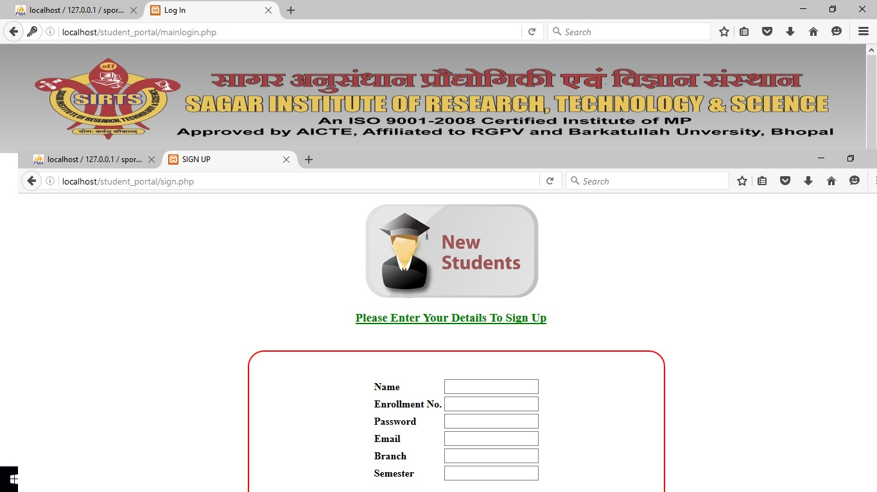
Sign Up

Slide 7
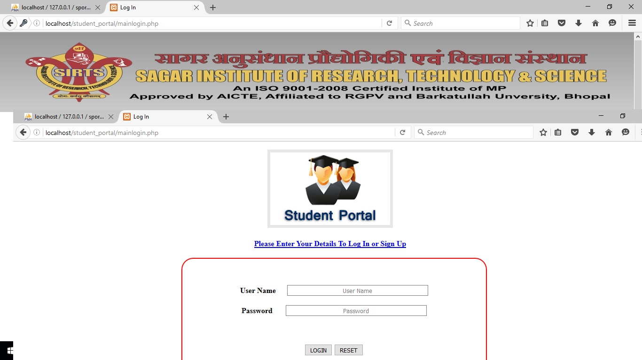
Log In

Slide 8
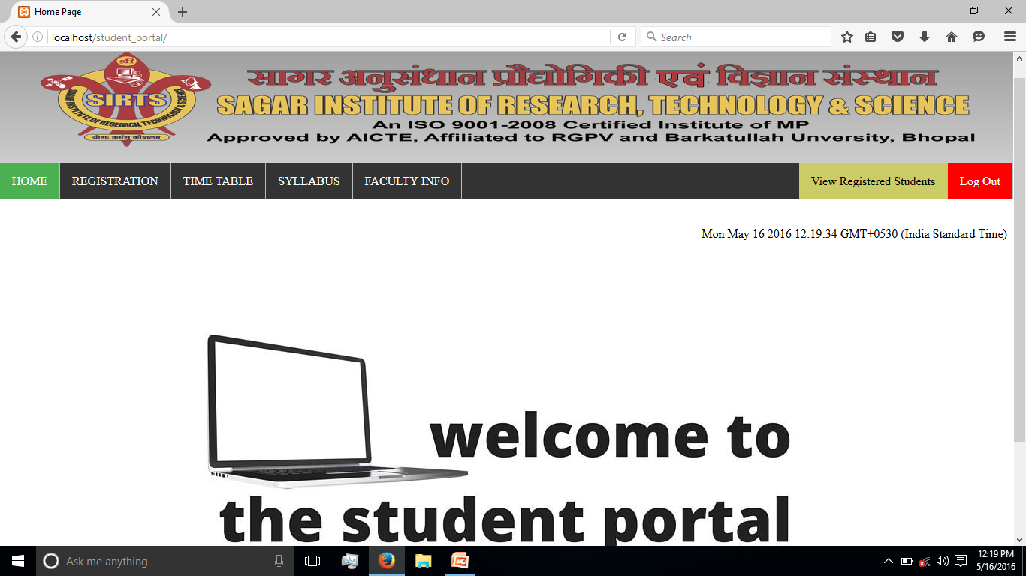
Home

Slide 9
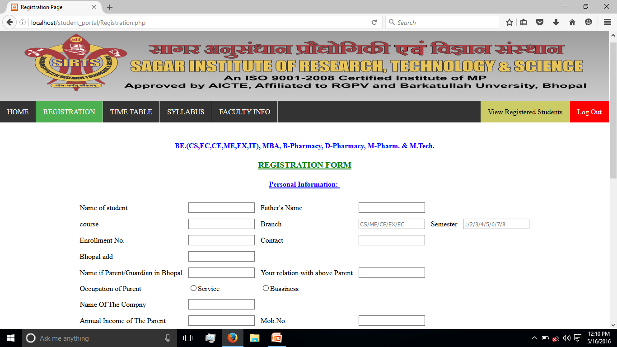
Registration

Slide 10
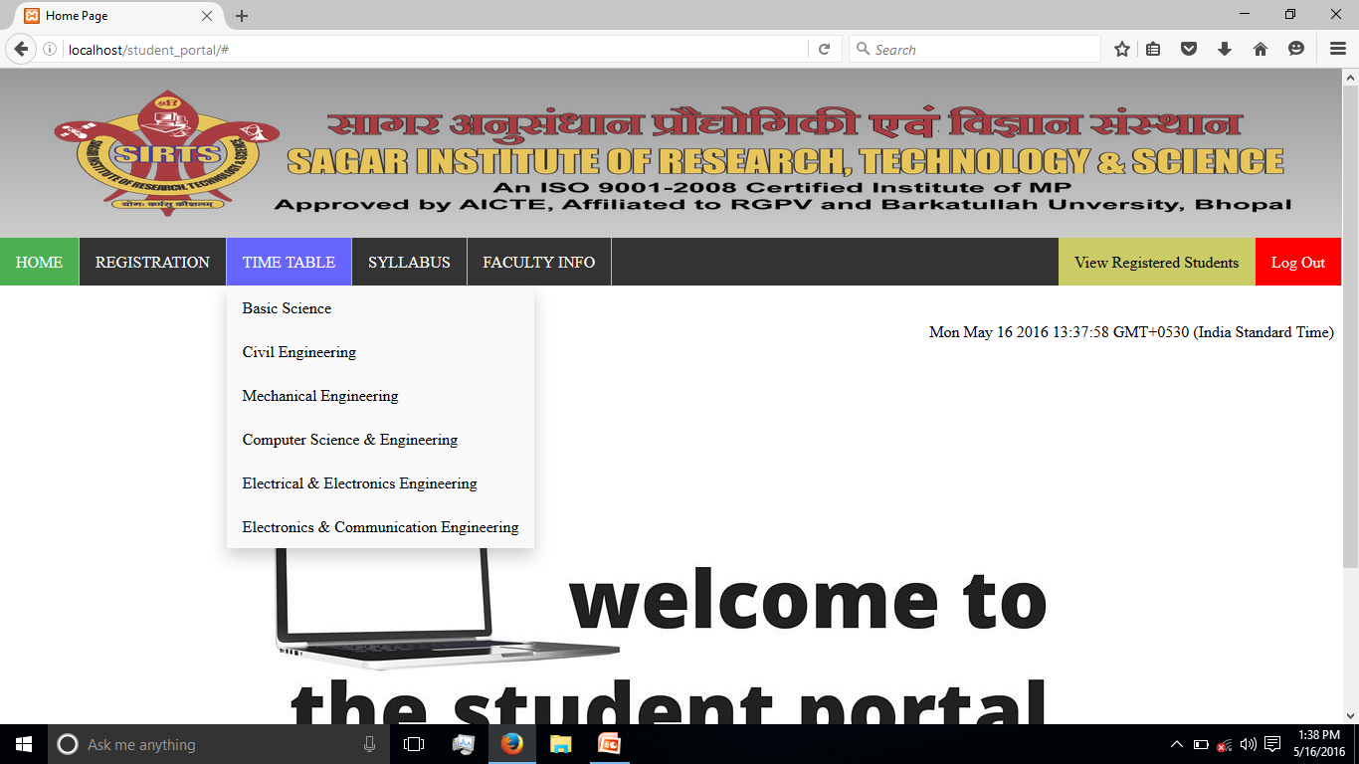
Time Table

Slide 11
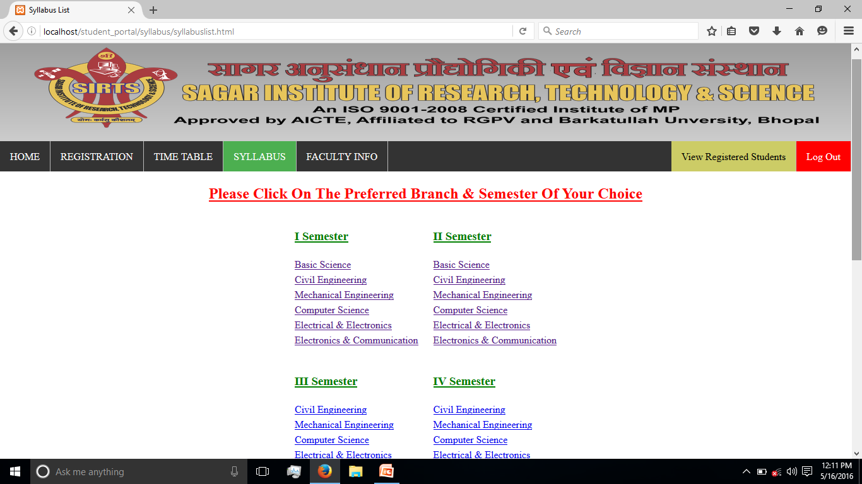
Syllabus

Slide 12
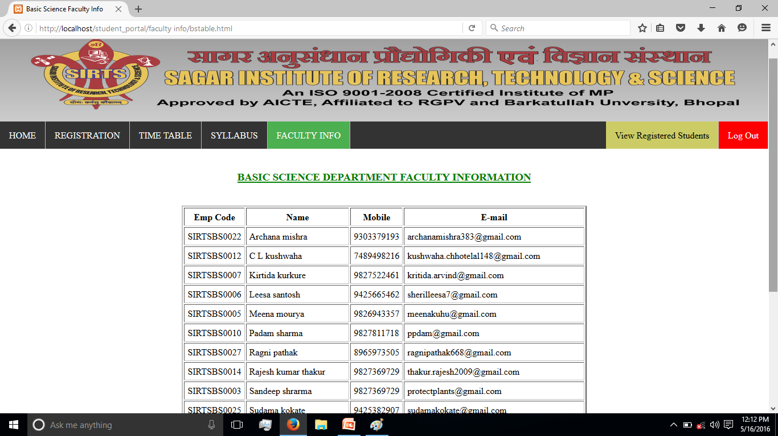
Faculty Info

Slide 13
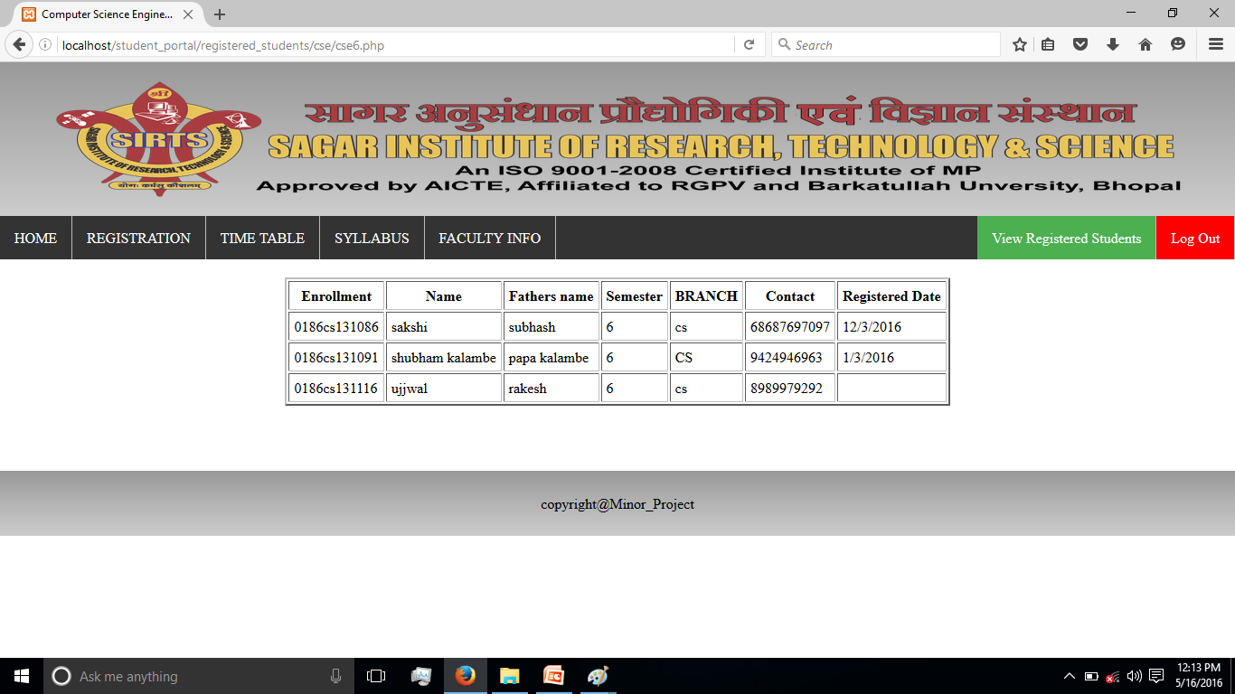
View Registered Students

Slide 14
THANK YOU

